Slide 1
Adaptive Step Sizes for Subgradient Optimization Methods
Charles Tsao
Stanford University Mentor: Nicholas Dwork Advisor: John Pauly August 2018

Slide 2

Goal
To optimize a (possibly non-differentiable) convex function
$$minimize f\left(x\right)$$
A function is convex if a line between any two points on the function lie above or on it.

Slide 3
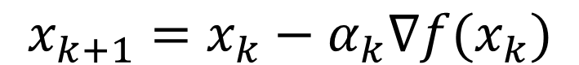
Gradient Descent
$$x_{k+1}=x_{k}−α_{k}∇f(x_{k})$$
Small Fixed Step Size
Large Fixed Step Size
For step sizes that are small enough, gradient descent is guaranteed to converge
Notes:
A simple method for optimizing differentiable functions
What happens with a large fixed step size?

Slide 4
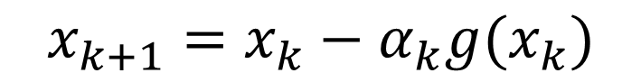
Subgradient:
The slope of a line that lies underneath the function locally
In higher dimensions, the subgradient is the normal vector
of a hyperplane that lies underneath the function locally
Subgradient optimization method:
At a differentiable point, the only subgradient is the gradient
$$x_{k+1}=x_{k}−α_{k}{g(x}_{k})$$
Notes:
Non-differentiable

Slide 5
Examples of a Small Fixed Step Size
Subgradient Optimization doesn’t converge to the optimal point!!
Notes:
- What does SGD look like for a small fixed step size?
- Gradient Descent converges beautifully!
- Subgradient descent DOESN’T converge

Slide 6
Examples of a Large Fixed Step Size
Subgradient Optimization doesn’t converge to the optimal point!!
Notes:
Again, what about a large fixed step size?

Slide 7
Convergence Theorem
For a given step size, subgradient optimization will move closer to the optimal point until it is within a threshold distance
Guaranteed to move within a threshold distance, not the optimal point
Large step size:
Fast, but never gets close to the optimal point
Notes:
We can describe this behavior
Unlike gradient descent, SGD doesn’t

Slide 8
Convergence Theorem
For a given step size, subgradient optimization will move closer to the optimal point until it is within a threshold distance
Guaranteed to move within a threshold distance, not the optimal point
Small step size:
Gets closer to the optimal point, but slow

Slide 9
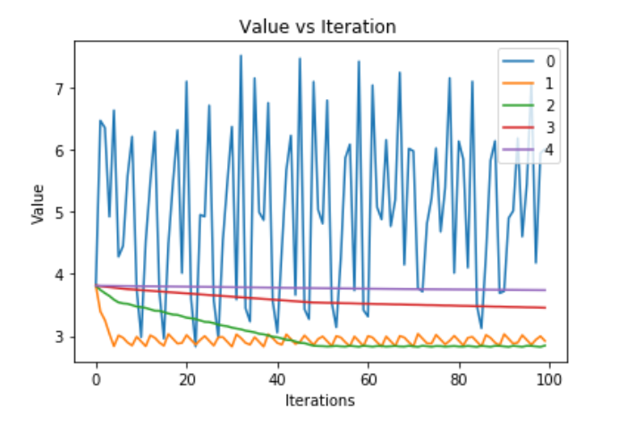
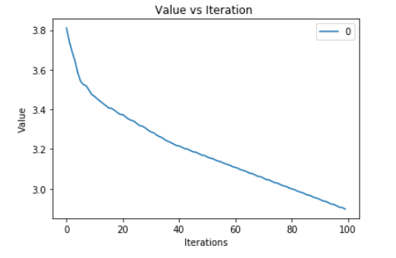
Subgradient descent can be costly:
Test different step sizes
Time/computationally expensive
What we want:
Notes:
Minimize time, maximize accuracy
We want to CONSTANTLY MAKE PROGRESS

Slide 10
To guarantee convergence:
Use a step size that decreases with every iteration
Step size = 1/m (harmonic series)
Decreasing step size:
Converges to optimal point, but EXTREMELY slow
Notes:
How will SGD converge?
Step size gets to slow too quickly,
painful

Slide 11
Existing Adaptive Method
Decrease the step size when the rate of change of the objective value becomes low
m = -1e-2
Notes:
In order to avoid this
This adaptive method will not change the step size
THEN THIS METHOD
Our algorithm avoids this problem

Slide 12
Our Idea
Automatically determine when the trajectory bounces around the optimal point
Reduce the step size when this occurs
We can use information in the history of the trajectory to automate this process
Notes:
We want this process to be automatic, so that when there is bouncing, we reduce the step size

Slide 13
Our Approach
Threshold =
Step size = 1
Notes:
Here’s the concept of our approach
We take the last four trajectory points of SGD and calculate these 3 unit step vectors.
Then mean, then magnitude
Because the length is large, making good progress towards opt

Slide 14
Our Approach
Threshold =
Step size = 1
Notes:
3 unit step vectors

Slide 15
Our Approach
Threshold =
Step size = 1

Slide 16
Our Approach
Threshold =
Step size = 1

Slide 17
Our Approach
Threshold =
Step size = 1

Slide 18
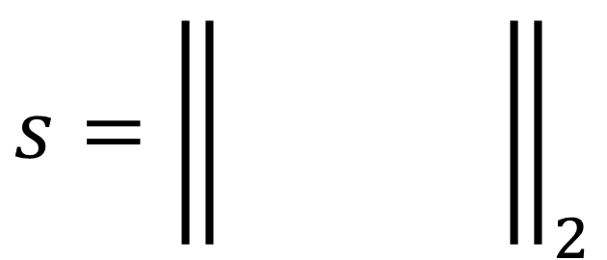
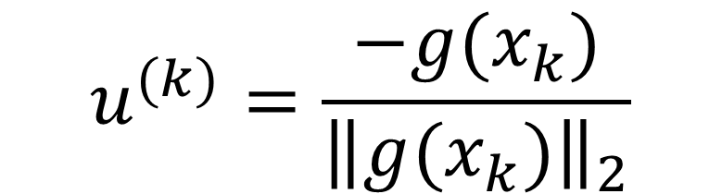
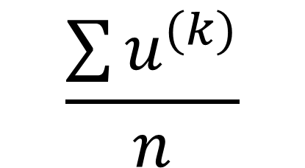
Our Approach
Metric to determine bouncing:
Compute the unit step vector of each of the last n subgradients
Compute the mean of the last n unit step vectors
Compute the norm of the mean unit step vector
When s < threshold:
Decrease step size to 1/m
$$s={\left\| \frac{\sum{X^{(k)}}}{n} \right\|}_{2}$$
$$u^{(k)}=\frac{−g(x_{k})}{{\left\|g(x_{k})\right\|}_{2}}$$
$$\frac{\sum{u^{(k)}}}{n}$$
Notes:
Here’s the metric that determines when trajectory is

Slide 19
Our Approach (example)
Threshold =
Step size = 1

Slide 20
Our Approach (example)
Threshold =
Step size = 1

Slide 21
Our Approach (example)
Threshold =
Step size = 1

Slide 22
Our Approach (example)
Threshold =
Step size = 1

Slide 23
Our Approach (example)
Threshold =
Step size = 1

Slide 24
Our Approach (example)
Threshold =
Step size = 0.5
Notes:
Then we wait for the next four trajectories with this step size

Slide 25
Our Approach (example)
Threshold =
Step size = 0.3333

Slide 26
Our Approach (example)
Threshold =
Step size = 0.1666

Slide 27
Convergence Theorem
m = 2
for I iterations:
append subgradient to subgradientSet
if subgradientSet size is 10:
add unit vector of each subgradient in subgradientSet to unitSubGradientSet
averageStep = mean of unitSubGradientSet
s = L2 norm of averageStep
if s < threshold
alpha is divided by m
m++
subgradientSet is reset to empty
else:
subgradientSet removes oldest element
Notes:
Ensure our algorithm converges onto optimal point
Here’s some pseudocode fleshing
10 points of traj hist

Slide 28
Convergence Theorem
m = 2
for I iterations:
append subgradient to subgradientSet
if subgradientSet size is 10:
add unit vector of each subgradient in subgradientSet to unitSubGradientSet
averageStep = mean of unitSubGradientSet
s = L2 norm of averageStep
if s < threshold or same alpha used for 1000 iterations
alpha is divided by m
m++
subgradientSet is reset to empty
else:
subgradientSet removes oldest element
Notes:
Changing the step size after x amount of iterations guarantees convergence;
The trajectory might move around the threshold area
Algorithm guarantees convergence, results

Slide 29
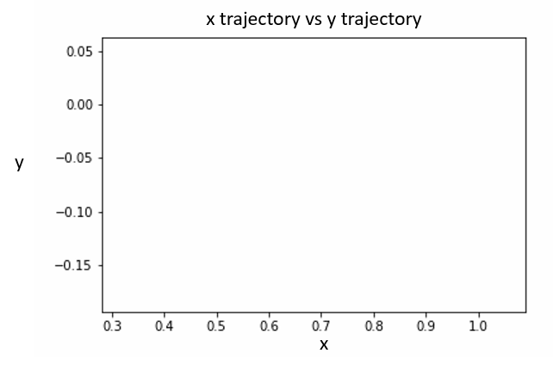

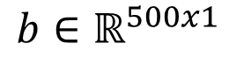
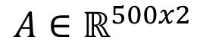
Results
Minimize the maximum of a set of planes:
$f(x) = \max_{i}{( A_{i}x+b_{i} ) }⁡$where and
$$A∈ℝ^{500x2}$$
$$b∈ℝ^{500x1}$$

Slide 30
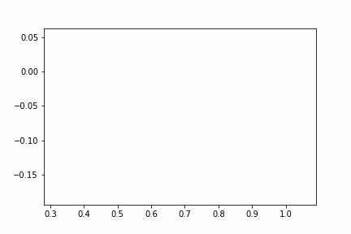
Result: Fixed Step Size
Minimize the maximum of a set of planes:
$f(x) = \max_{i}{( A_{i}x+b_{i} ) }⁡$where and
$$A∈ℝ^{500x2}$$
$$b∈ℝ^{500x1}$$
x trajectory vs y trajectory
y
x

Slide 31
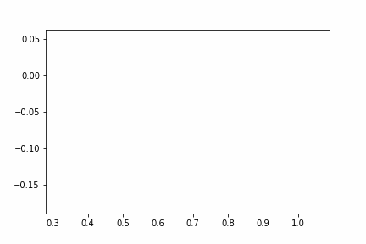
Result: Decreasing Step Size
Minimize the maximum of a set of planes:
$f(x) = \max_{i}{( A_{i}x+b_{i} ) }⁡$where and
$$A∈ℝ^{500x2}$$
$$b∈ℝ^{500x1}$$
x trajectory vs y trajectory
y
x

Slide 32
Result: AdaGrad Optimization
Minimize the maximum of a set of planes:
$f(x) = \max_{i}{( A_{i}x+b_{i} ) }⁡$where and
$$A∈ℝ^{500x2}$$
$$b∈ℝ^{500x1}$$
x trajectory vs y trajectory
y
x

Slide 33
Result: Adaptive Step Size
Minimize the maximum of a set of planes:
$f(x) = \max_{i}{( A_{i}x+b_{i} ) }⁡$where and
$$A∈ℝ^{500x2}$$
$$b∈ℝ^{500x1}$$
x trajectory vs y trajectory
y
x

Slide 34
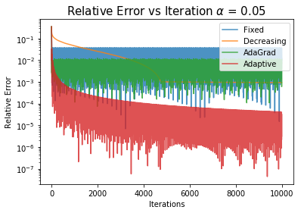
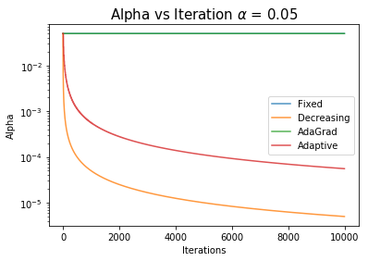

Results
Minimize the maximum of a set of planes:
$f(x) = \max_{i}{( A_{i}x+b_{i} ) }⁡$where and
$$A∈ℝ^{500x2}$$
$$b∈ℝ^{500x1}$$
Threshold = 0.5
Notes:
So here’s a plot

Slide 35
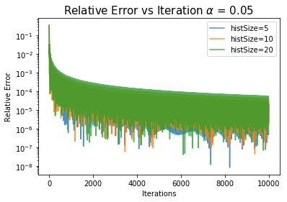
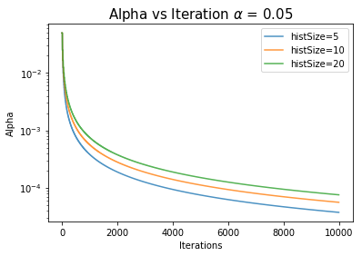
Results (different histSize)
Minimize the maximum of a set of planes:
$f(x) = \max_{i}{( A_{i}x+b_{i} ) }⁡$where and
$$A∈ℝ^{500x2}$$
$$b∈ℝ^{500x1}$$
Threshold = 0.5
Notes:
So here’s a plot

Slide 36
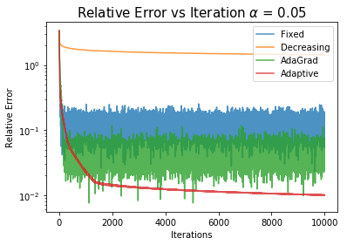
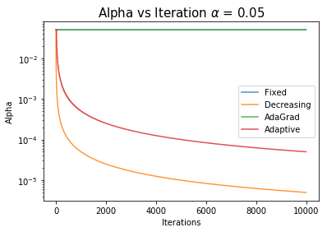
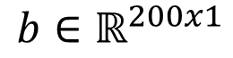
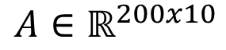
Results (more complex problem)
Minimize the maximum of a set of planes:
$f(x) = \max_{i}{( A_{i}x+b_{i} ) }⁡$where and
$$A∈ℝ^{200x10}$$
$$b∈ℝ^{200x1}$$
Threshold = 0.5

Slide 37
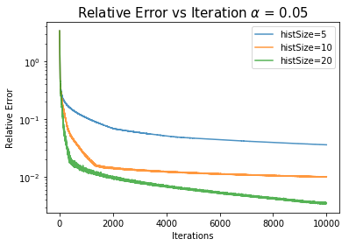
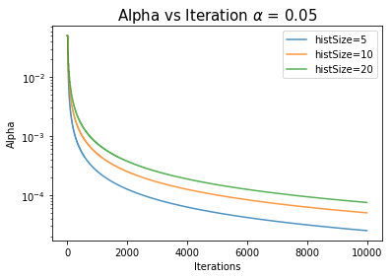
Results (more complex problem, different histSize)
Minimize the maximum of a set of planes:
$f(x) = \max_{i}{( A_{i}x+b_{i} ) }⁡$where and
$$A∈ℝ^{200x10}$$
$$b∈ℝ^{200x1}$$
Threshold = 0.5

Slide 38
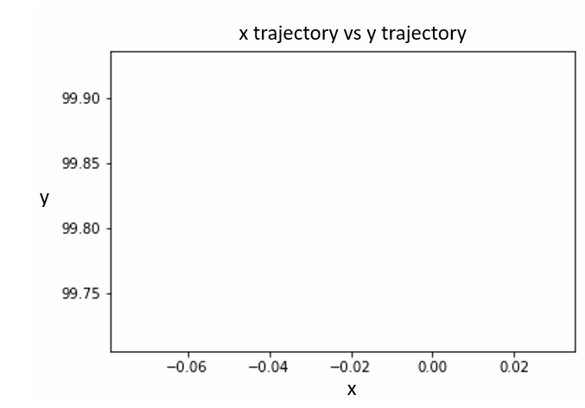
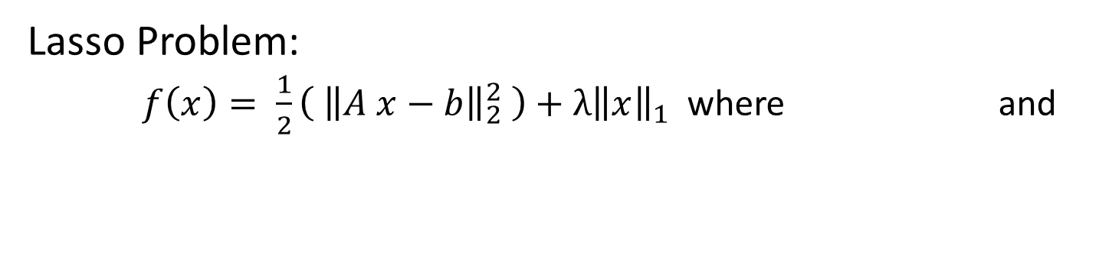
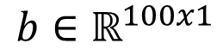
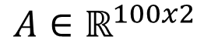
Result: Fixed Step Size
Lasso Problem:
$f\left(x\right)= \frac{1}{2}\left( {\left\|A x−b\right\|}_{2}^{2} \right)+{λ\left\|x\right\|}_{1}$ where and
$$A∈ℝ^{100x2}$$
$$b∈ℝ^{100x1}$$

Slide 39
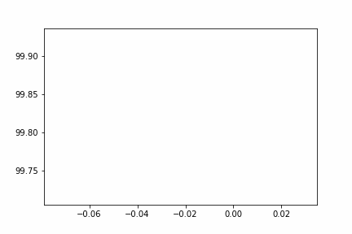
Result: Fixed Step Size
Lasso Problem:
$f\left(x\right)= \frac{1}{2}\left( {\left\|A x−b\right\|}_{2}^{2} \right)+{λ\left\|x\right\|}_{1}$ where and
$$A∈ℝ^{100x2}$$
$$b∈ℝ^{100x1}$$
x trajectory vs y trajectory
y
x
Notes:
Make a new trajectory plot animation

Slide 40
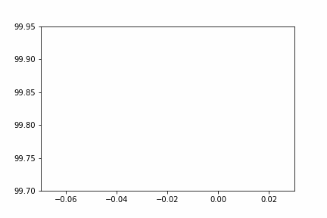
Result: Decreasing Step Size
Lasso Problem:
$f\left(x\right)= \frac{1}{2}\left( {\left\|A x−b\right\|}_{2}^{2} \right)+{λ\left\|x\right\|}_{1}$ where and
$$A∈ℝ^{100x2}$$
$$b∈ℝ^{100x1}$$
x trajectory vs y trajectory
y
x
Notes:
Make a new trajectory plot animation

Slide 41
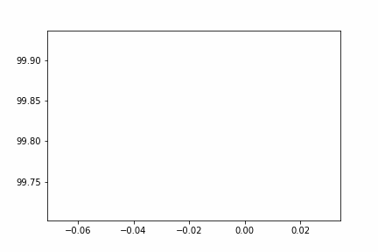
Result: AdaGrad Optimization
Lasso Problem:
$f\left(x\right)= \frac{1}{2}\left( {\left\|A x−b\right\|}_{2}^{2} \right)+{λ\left\|x\right\|}_{1}$ where and
$$A∈ℝ^{100x2}$$
$$b∈ℝ^{100x1}$$
x trajectory vs y trajectory
y
x
Notes:
Make a new trajectory plot animation

Slide 42
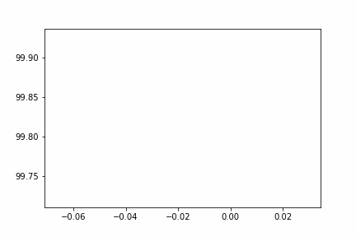
Result: Adaptive Step Size
Lasso Problem:
$f\left(x\right)= \frac{1}{2}\left( {\left\|A x−b\right\|}_{2}^{2} \right)+{λ\left\|x\right\|}_{1}$ where and
$$A∈ℝ^{100x2}$$
$$b∈ℝ^{100x1}$$
x trajectory vs y trajectory
y
x
Notes:
Make a new trajectory plot animation

Slide 43
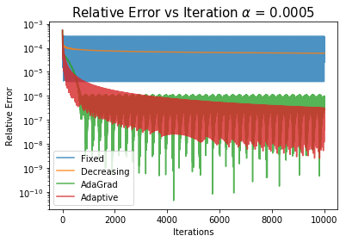
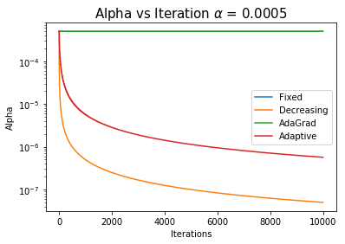
Results
Lasso Problem:
$f\left(x\right)= \frac{1}{2}\left( {\left\|A x−b\right\|}_{2}^{2} \right)+{λ\left\|x\right\|}_{1}$ where and
$$A∈ℝ^{100x2}$$
$$b∈ℝ^{100x1}$$
Threshold = 0.5

Slide 44
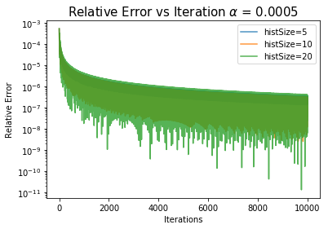
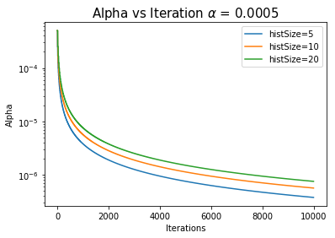
Results (different histSize)
Lasso Problem:
$f\left(x\right)= \frac{1}{2}\left( {\left\|A x−b\right\|}_{2}^{2} \right)+{λ\left\|x\right\|}_{1}$ where and
$$A∈ℝ^{100x2}$$
$$b∈ℝ^{100x1}$$
Threshold = 0.5

Slide 45
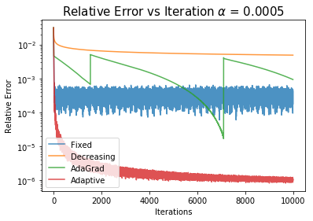

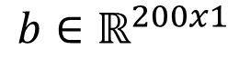
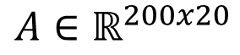
Results (more complex problem)
Lasso Problem:
$f\left(x\right)= \frac{1}{2}\left( {\left\|A x−b\right\|}_{2}^{2} \right)+{λ\left\|x\right\|}_{1}$ where and
$$A∈ℝ^{200x20}$$
$$b∈ℝ^{200x1}$$
Threshold = 0.5

Slide 46
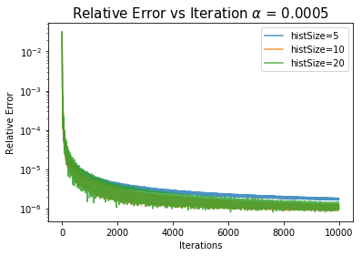
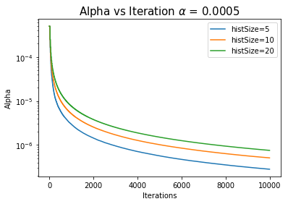
Results (more complex problem, different histSize)
Lasso Problem:
$f\left(x\right)= \frac{1}{2}\left( {\left\|A x−b\right\|}_{2}^{2} \right)+{λ\left\|x\right\|}_{1}$ where and
$$A∈ℝ^{200x20}$$
$$b∈ℝ^{200x1}$$
Threshold = 0.5

Slide 47
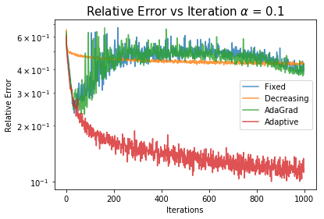
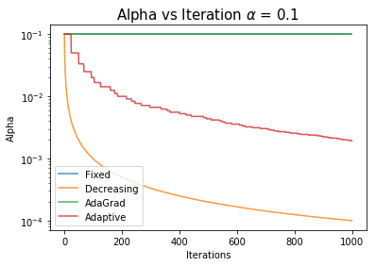
Results (Neural Network)
ResNet on CIFAR-10 with L1 norm reg.
Threshold = 0.5

Slide 48
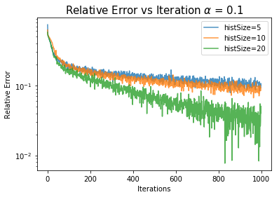
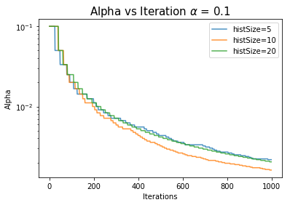
Results (Neural Network)
ResNet on CIFAR-10 with L1 norm reg.
Threshold = 0.5

Slide 49
Conclusion
The history of the trajectory contains valuable information for adaptively selecting the step size for the subgradient optimization method
This adaptive subgradient descent reaches the optimal point with more speed and accuracy
Tradeoffs:
Retaining the history of the trajectory requires additional memory
Requires more processing

Slide 50
Future Work
See if adapting the step size for each component of the subgradient individually improves performance
See if this algorithm can be combined with AdaGrad or Adam for additional improvement
Notes:
Maybe the trajectory is bouncing around only in the horizontal direction but not the vertical direction. In that case, it’d be better to just reduce the step size of the horizontal component and leave the step size of the vertical component.

Slide 51
Thank you
Special thanks to David Zeng for setting up our computing environment.

